Slide 1
Examining and Addressing Taxpayer Expectations for Affordable Care Act Automated Information
Ariel S. Wooten & Marisa E. McDaniels
Internal Revenue Service
Wage & Investment Research and Analysis (WIRA)
June 18, 2015

Slide 2
Table of Contents
Background | 3
Study Participants | 4
Testing Locations | 5
Testing Sessions | 6
Comprehension Testing | 7
Toll-Free Ratings and Focus Groups | 8
Comprehension Testing Findings | 9
Toll-Free Ratings Results | 12
Focus Group Themes | 14
Research in Action | 15
Conclusions | 16

Slide 3
Background
Objective:
To explore and capture taxpayer expectations for receiving Affordable Care Act (ACA) information provided through the Internal Revenue Service (IRS) automated phone line.
Benefits of the Research:
Allow the IRS to pre-emptively plan and allocate resources based on taxpayer experience and expectations rather than relying on lessons learned during implementation.
Assist in making informed decisions to improve level of service, facilitate voluntary compliance, and reduce taxpayer and IRS burden by incorporating taxpayers’ perspective.

Slide 4
Study Participants
Eligibility requirements:
  18 years of age or older
  Taxpayers who earned wages in tax year 2013
  Filed a tax year 2013 tax return between January 31, 2014 and April 15, 2014.
The sampling pool was stratified based on gender, age, filing status, tax return preparation method, and adjusted gross income (AGI).
IRS provided a contractor with a list of taxpayers who met the criteria in order to complete study recruitment.
119 taxpayers (80 individual participants and 39 small business participants) were recruited.

Slide 5
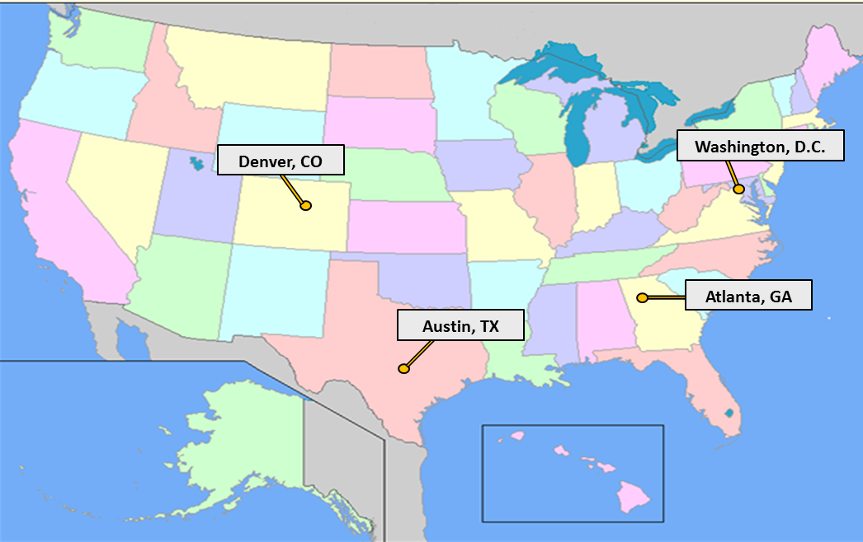
Testing Locations
Four geographically diverse cities were selected to host testing sessions.
A total of 12 testing sessions (three per city) were conducted at IRS facilities in Washington, D.C.; Austin, TX; Denver, CO and Atlanta, GA.

Slide 6
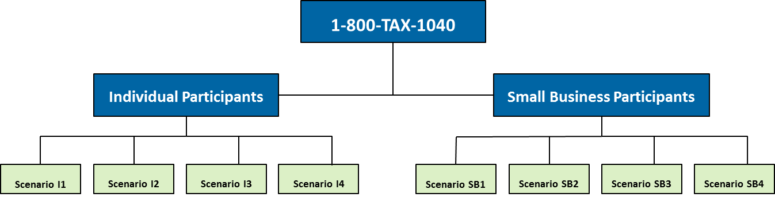
Testing Sessions
Each 90 minute session consisted of a three-part testing sequence used to evaluate the Health Care Detail phone line and the Automated ACA Information phone line:
Comprehension Testing: Participants were provided a series of fictional scenarios and asked to answer comprehension questions.
Toll-Free Ratings Sheet: Participants then completed a questionnaire evaluating their experience using the toll-free automated line.
Focus Group: Participants shared their overall user experience and recommendations during a focus group discussion.

Slide 7
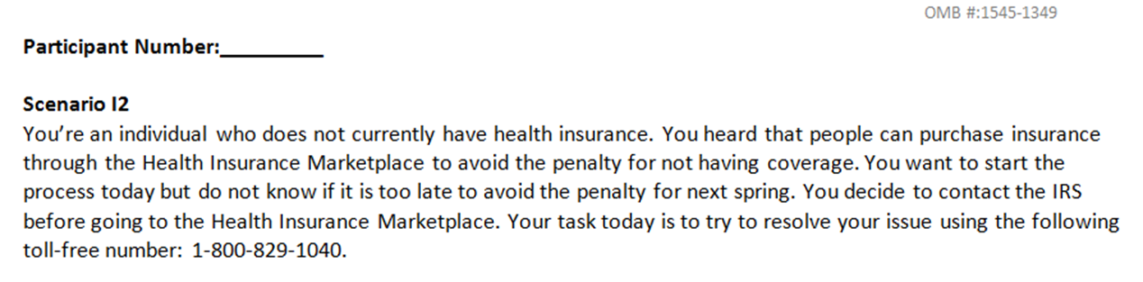
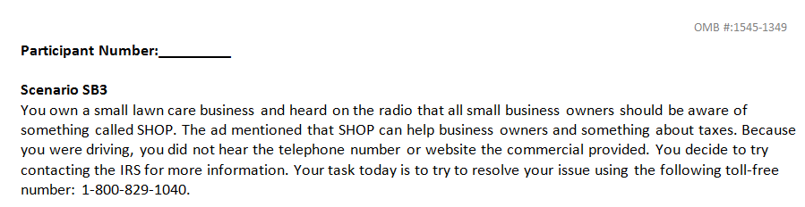
Comprehension Testing
To facilitate a realistic experience, participants were provided fictional scenarios (based on the automated content) to use while calling into the toll-free line. Participants were asked to answer comprehension questions to determine how well they understood the information.

Slide 8
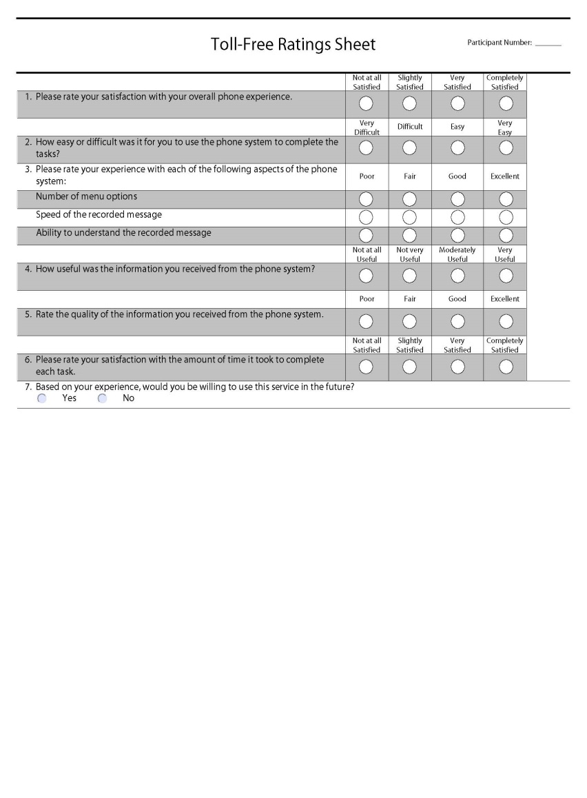
Toll Free Ratings and Focus Groups
As part of the testing session, participants were asked to rate their experience, overall satisfaction, and future willingness to use the ACA toll-free automated phone line using a four-point rating scale.
During the focus group portion of the testing session, participants were asked to share feedback on their experience and provide recommendations for improvement.

Slide 9
Comprehension Testing Findings
Overall, both individual and small business participants experienced difficulty navigating the toll-free line and often were not able to reach the intended information.
Across all scenarios, 80% to 100% of individual participants correctly identified either IRS.gov or Healthcare.gov as sources for additional information compared to 45% to 75% of small business participants.
Nearly half (46%) of all responses from small business participants and over three quarters (76%) of all responses from individual participants reveal that participants self-reported being unable to successfully resolve their issue in the allotted time.
Approximately 65% of responses from individual participants and 42% of responses from small business participants indicated a desire to speak to an assistor while working through the scenarios.

Slide 10
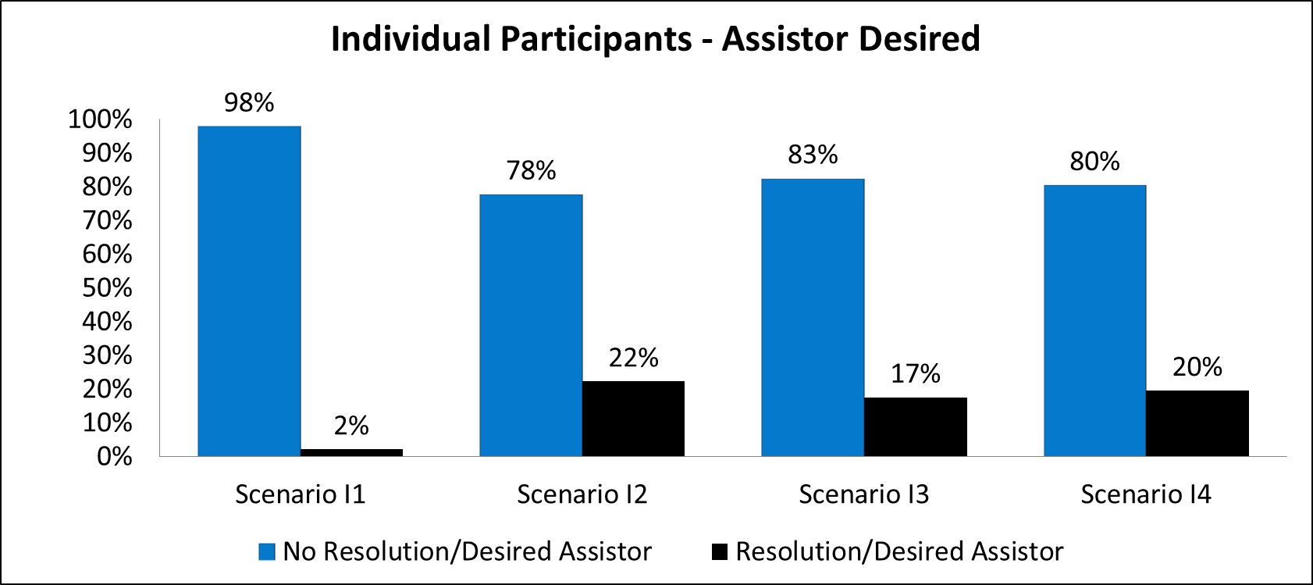
Comprehension Testing Findings
Across all scenarios, individual participants who reported being unable to resolve their issue were overwhelmingly more likely to desire to speak to an assistor when compared to individual participants reporting issue resolution.

Slide 11
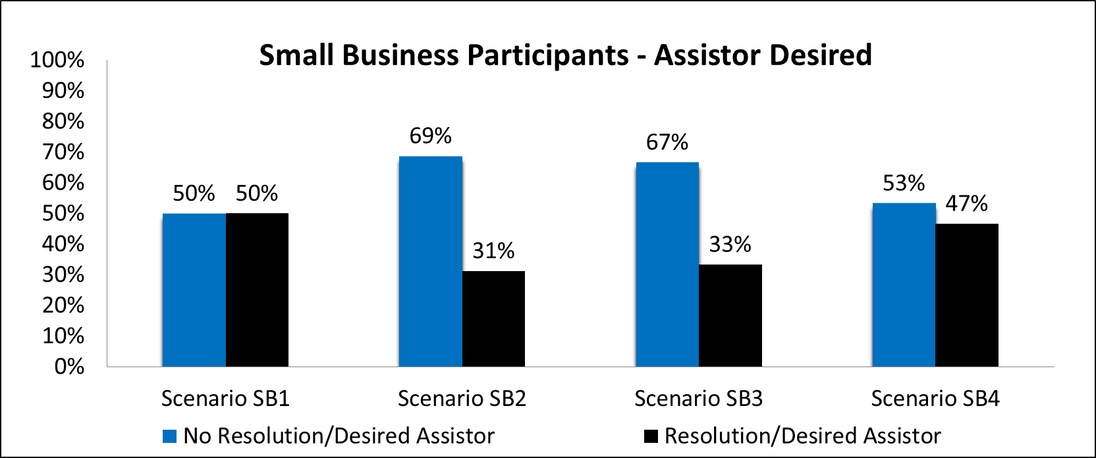
Comprehension Testing Findings
Despite variation across scenarios, overall, small business participants who reported being unable to resolve their issue were more likely to indicate a desire to speak to an assistor when compared to small business participants who reported issue resolution.

Slide 12
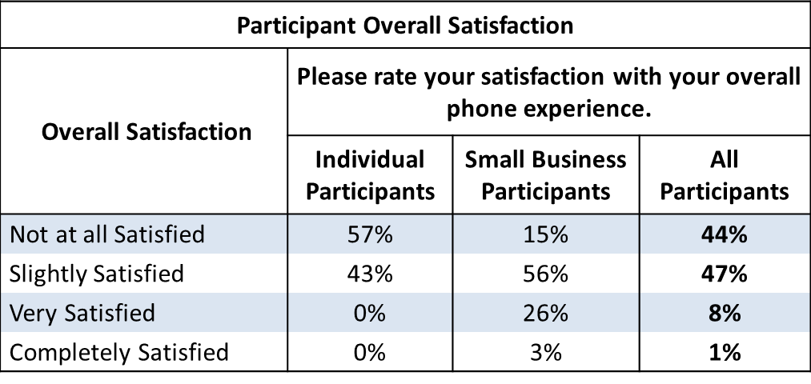
Toll-Free Ratings Results
Individual participants reported not being satisfied (57% not at all satisfied) and experienced varying levels of difficulty while completing the tasks (27% very difficult, 33% difficult).
Small business participants were more satisfied (56% slightly satisfied) and reported that the tasks were easy to complete (61% easy).
Overall, 67% of participants reported being unwilling to use the automated phone service in the future.

Slide 13
Focus Group Themes
The qualitative testing session data was collected by WIRA through focus groups to better understand the taxpayer experience using the ACA toll-free line and obtain common themes.
Participants do not understand the IRS’s role in implementing ACA in comparison to other agencies.
  “I think if they could, it would be better if they separated. If you wanted to find out about healthcare that you wouldn't be working, doing anything, with the IRS at all unless you had a specific question about your taxes, having to do with healthcare.”¹
When calling the toll-free line, participants would prefer to resolve their issue within that service channel.
  “If I'm calling the phone number, it's because I want information from the phone number. If I was going to go to the website, I would've started with the website.”²
Participants’ expectations impact satisfaction.
  “I expected that I could push buttons and get a recorded answer to the question. That didn't happen. Then I thought I'd probably be able to find a person. That didn't happen, and then I thought, ‘Am I doing this right?’”³

Slide 14
Focus Group Themes
The participants have a genuine desire to be compliant, but require more detailed information.
  “You're calling to gain information. Some of what she was telling you, could answer your question. But if it doesn't answer your question, you kind of zone out, trying to get to-- how do I get my question answered?”⁴
Making other information channels available would be appreciated.
  “I think maybe even better than this approach would be a live chat. You know how you do that, when you've got computer problems, and you can type in something? You usually get a response a lot quicker.”⁵
  “Call back, that's a good idea. Automatically call you back when they’re ready.”⁶
Changes to certain logistical elements of the phone tool will create a smoother user experience.
  “I found the computer voice distracting, as opposed to a real recorded person's voice.”⁷

Slide 15
Research in Action
In November 2014, an IRS cross-functional workgroup participated in a two-day ACA Toll-Free Design Meeting.
  The purpose of this meeting was to craft proposed ACA-related verbiage changes to the IRS automated phone line.
  Critical components to this collaborative effort were the consideration of key findings and recommendations from this research study along with the application of subject matter expertise in drafting prompt/message changes.
Changes to the content, organization, and delivery of information on the ACA automated line went live on 01-16-2015, helping to shape taxpayer expectations as the IRS geared up for the start of the 2015 Tax Filing Season.
The revised scripts set taxpayer expectations upfront related to live assistance helping ease and/or avoid the frustration of taxpayers who can unnecessarily find themselves caught in an endless loop of automated messages while trying to reach a live assistor.

Slide 16
Conclusions
As outlined in the IRS Strategic Plan, the IRS is dedicated to “taking proactive steps to better understand issues from the taxpayer’s perspective.”
This research provides data to assist the IRS in making decisions that will improve level of service, facilitate voluntary compliance, and reduce taxpayer burden by:
  Shaping and informing expectations to improve overall user satisfaction
  Ensuring operational decisions are made only after considering the views of affected taxpayers through an informed understanding of the taxpayer experience and perspective.
Key findings from this research offer insight for improvements to automated telephone messages and associated content with the goal of striking the optimal balance of providing necessary and relevant information through automation to answer taxpayers questions and/or resolve their issues without having the need to wait in queue to speak with a live assistor.

Slide 17
Project Team
    Ariel S. Wooten, Project Lead
    Social Scientist, WIRA Research Group 4
    Ariel.Wooten@irs.gov
    Marisa E. McDaniels
    Operations Research Analyst, WIRA Research Group 4
    Marisa.McDaniels@irs.gov
    David C. Cico
    Chief, WIRA Research Group 4
    Patti Davis-Smith
    Social Scientist, WIRA Research Group 4
    Maria Wang
    Operations Research Analyst, WIRA Research Group 4
    Robert Thomas
    Social Scientist, WIRA Research Group 4
    Julie Evans
    Program Analyst, Program Evaluation and Improvement
    Toni Cross
    Director, WIRA

