Slide 1

Taxpayer Behavior under Audit Certainty
Ben Ayers, Jeri Seidman & Erin Towery
IRS Research Conference
June 18th, 2015

Slide 2
Motivation
Strategic tax compliance model
  Probability of tax audit changes with taxpayer actions
  Taxpayers condition their actions on expected audit probability

Slide 3
Motivation
What happens when audit probability equals 1?
  Strategic tax model does not posit corner solution
  Blumenthal et al. (2001) and Mills & Sansing (2001) suggest the taxpayer might be more aggressive
  Hoopes et al. (2012) and DeBacker et al. (2013) suggest the taxpayer might be less aggressive

Slide 4
Research question

Slide 5
CIC program
IRS implemented CIC program in 1960s
LB&I Team spends substantial time in taxpayer’s office during year
IRS assigns firms to program based on point scheme
Firms remain in CIC program until audit no longer requires team audit approach
Between 500-1,500 taxpayers in CIC program per year

Slide 6
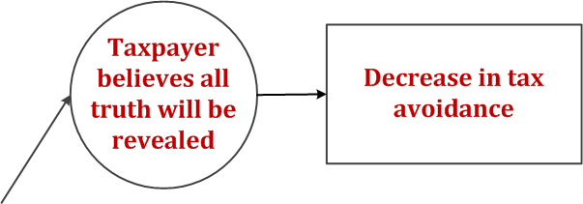
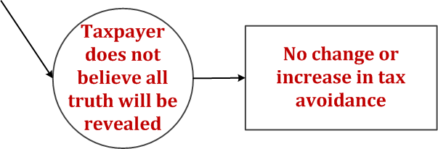
Hypothesis

Slide 7
Hypothesis
Hypothesis: Audit certainty does not affect taxpayer behavior.

Slide 8
Research design
Determinants of CIC assignment
  Size variables: Total Assets; Net Sales
  Complexity variables: # of geographic segments; # of business segments; Foreign Sales; Foreign Tax
  Firm attributes: Leverage; R&D; Capital Intensity; Excess stock benefits; net operating losses
CICFirm = α + β*Size + γ*Complexity + ε
CICFirm = α + β*Size + γ*Complexity + δ*FirmAttributes + ε

Slide 9
Research design
Multivariate regression for effect of tax certainty on taxpayer behavior
  Tax = Fed_Cash_ETR, Cash_ETR, UTB_CY_ADD
  POST = 1 for both CIC firm and matched firm for all years after CIC entrance
  ∆Firm = 1 for firms entering the CIC program during our sample period
Tax = β₀ + β₁*POST + β₂*∆Firm + β₃* POST*∆Firm
+ Controls + ε

Slide 10
Research design
Multivariate regression for effect of tax certainty on taxpayer behavior
  Matched firm samples constructed using CIC determinants model
  β₃ = 0 → No change in tax behavior
  β₃ > 0 → Increase in tax payments when entering CIC program
  β₃ < 0 → Decrease in tax payments when entering CIC program
Tax = β₀ + β₁*POST + β₂*∆Firm + β₃* POST*∆Firm
+ Controls + ε

Slide 11
Sample

Slide 12
CIC prediction (n=23,094)

Slide 13
Effect of CIC on Fed_Cash_ETR

Slide 14
Effect of CIC on Cash_ETR

Slide 15
Effect of CIC on UTB_CY_ADD

Slide 16
Conclusion
Use dataset of CIC firms to:
  Build CIC determinants model
  Examine the effect of audit certainty on tax avoidance
Findings suggest:
  Size and complexity main determinants of CIC assignment
  CIC program alters managers’ expectations regarding future tax payments, but does not have a significant deterrence effect
Important to IRS as it considers the costs and benefits of CIC program

