Slide 1
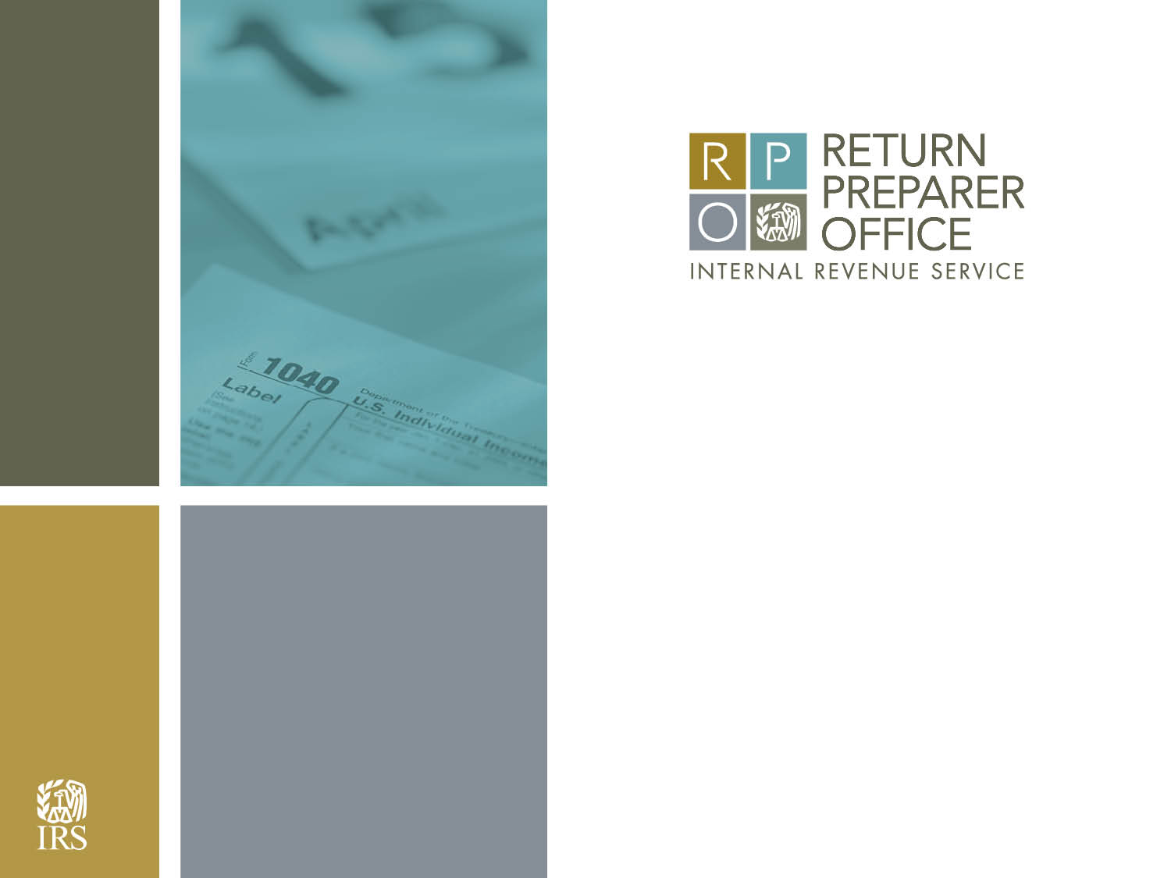
IRS Preparer-Level Treatment Tests
Karen Masken
June 18, 2015

Slide 2
Disclaimer
The views expressed here are those of the author and do not necessarily represent the views of the IRS

Slide 3
Introduction
Background
Motivation
Issues Addressed
Preparer Selection
Treatments
Evaluation Technique
Results
Summary

Slide 4
Background
In 2010, the Internal Revenue Service (IRS) adopted regulations aimed at establishing standards among tax return preparers.
By January 1, 2011, preparers were required to register with the IRS in order to receive a preparer tax identification number (PTIN) and enter it on returns they prepare.
The objective was to improve voluntary compliance by supporting the paid preparer community and providing oversight of the industry with the goal of reducing errors on tax returns.
The Return Preparer Office (RPO) was formed to meet this objective. The three primary strategic goals of RPO are:
  Register and promote a qualified tax professional community
  Improve the compliance and accuracy of returns prepared by tax professionals
  Support a stakeholder-focused culture that encourages voluntary compliance and continuous improvement

Slide 5
Background (cont.)
In 2012 RPO implemented a multi-year study to test the effectiveness of various treatments in moving preparers and their clients toward greater voluntary compliance
Goals of the study
  What types of treatments are cost effective
  Is effectiveness persistent (recidivism)
  Segmentation of preparers to minimize costs

Slide 6
Motivation
Compliance Spectrum
Compliant
Noncompliant / Fraud
Those towards the compliant end of the spectrum might be moved by inexpensive light touches / nudges e.g., letters
Those towards the noncompliant end of the spectrum may require more expensive and intrusive treatments e.g., audits / injunctions

Slide 7
Motivation (cont.)
Scarce treatment resources
Little is known about the effectiveness of preparer-based treatments
Traditionally IRS has focused enforcement resources on the non-compliant / fraud end of the spectrum
  These treatments are expensive
  Finding less costly but effective treatments for those in the middle of the spectrum could have a significant impact on voluntary compliance
Relied on non-targeted services (e.g., tax forums, webinars, etc.) to nudge preparers to be more compliant

Slide 8
Issues Addressed
Schedule C Net Income
  Schedule C accounts for almost 30% of Individual Income Tax gap (~$68 billion)
  Around 75% of Schedule C returns are paid prepared
  About 75% of paid prepared returns with Schedule C have errors
Additional Child Tax Credit (ACTC)
  Emerging Issue, particularly children w/ ITINs
  Around 65% of ACTC claims are paid prepared
  ~1% of preparers responsible for 60% of children w/ ITINs

Slide 9
Preparer Selection: Schedule C
Error detection model developed using National Research Program (NRP) data
Modeled at the taxpayer level then rolled up to the preparer
Endogeneity issue led to decision to select preparers with majority of their Schedule C returns flagged by the model

Slide 10
Preparer Selection: ACTC
No error detection model development
Based on prevalence of ACTC returns
Children w/ ITINs:
  At least 20 returns had ACTC children w/ ITINs
  At least 15% of ACTC returns had children w/ITINs
General ACTC:
  Did not meet above criteria
  At least 20 returns had ACTC claims
  Majority of returns had ACTC claims

Slide 11
Treatments: Schedule C
First Year (1250 preparers in each treatment):
Educational visit by Revenue Agent
Letter reminding preparers of due diligence requirements and warning they and or their clients may be audited
Letter with same message of due diligence but also suggesting preparer take continuing education regarding Schedule C
Second Year (1250 preparers in each treatment):
Educational Visit repeated
Due Diligence Letter sent to subgroup
Continuing Education Letter dropped

Slide 12
Treatments: ACTC
1. Educational letter explaining introduction of Schedule 8812 with emphasis on when children with ITINs qualify
  (3500 preparers)
2. Educational letter explaining introduction of Schedule 8812
(5000 preparers)

Slide 13
Evaluation Technique
Difference in Differences used for both
Schedule C
  Difference in success rate* before and after treatment
  Difference between test and control groups
* predefined as a 5 percentage point drop in returns selected
ACTC
  Difference in ACTC claims before and after treatment
  Difference between test and control groups

Slide 14
Results: Schedule C
Percentage Point Difference Between Test and Control Groups: Success Rates
 | Year 1 | Year 2
Educational Visit | 12 | 13
Due Diligence Letter | 7 | 9
Continuing Education Letter | 8 | n.a.
Percentage Point Difference Between Test and Control Groups: Recidivism Rates for Year 1 in Year 2
Educational Visit | -6
Due Diligence Letter | 2
Continuing Education Letter | -1

Slide 15
Results: Schedule C (cont.)
For Successful Test Group Preparers in Year 1:
 | Educational Visit | Due Diligence Letter | Continuing Education Letter
Number of Returns in 2013 | 140,900 | 113,000 | 123,800
Number of returns with Sch C | 37,000 | 31,200 | 32,000
Average percentage point decline in clients flagged | 19% | 17% | 18%
Est. number of taxpayers moved toward voluntary compliance | 7,100 | 5,400 | 5,800

Slide 16
Results: ACTC
Percentage Point Difference Between Test and Control Groups : Decline in Average Number
 | ITIN Letter | General Letter
ACTC Claims | 4 | 4
ACTC Children Claimed | 5 | 4
ACTC Children w/ ITINs | 10 | n.a.

Slide 17
Summary: Schedule C
All 3 treatments were found to be effective
Letters less effective overall but also much less costly
Results in year 2 are consistent with year 1
Results in year 1 are persistent in year 2
(Recidivism non-apparent)

Slide 18
Summary: ACTC
  Both treatments were found to be effective
  An educational letter can be a cost-effective way to improve voluntary compliance
  Targeted messaging, instead of expensive error detection models, can be a cost-effective way to improve voluntary compliance

