Slide 1
The Nontaxable Combat Pay Election and the EITC
Suzanne Gleason and Patricia K. Tong
IRS-TPC Research Conference
June 18, 2015
*These views are the authors and do not necessarily reflect those of the U.S. Department of the Treasury or the U.S Department of Defense.

Slide 2
Background
Combat zone tax exclusion: Military service members do not pay income taxes on any income received in any month in which they spent time in a combat zone.
Capped at $88,416 in 2009.
Earned income tax credit (EITC) is calculated based on earnings.
Exclusion of combat zone earnings will reduce the EITC among some low-income military members.

Slide 3
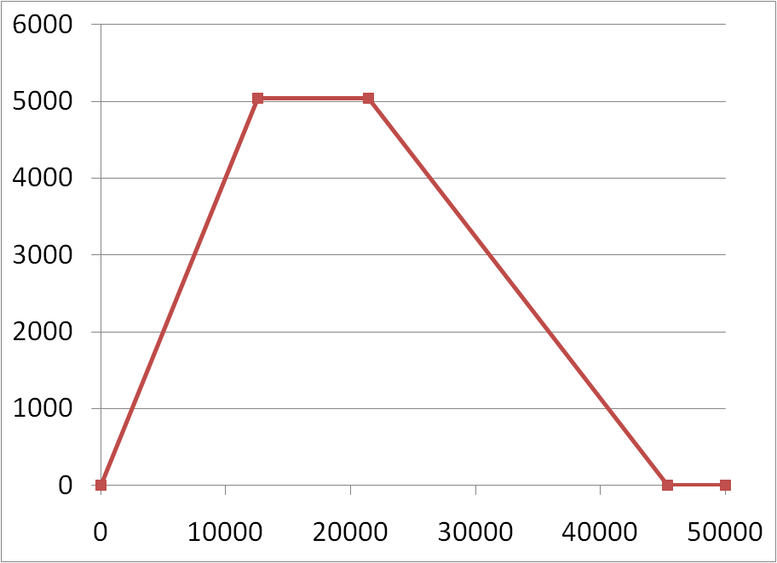
2009 EITC for Married Filing Jointly Couple with 2 Qualifying Children

Slide 4
Nontaxable Combat Pay Election (NCPE)
Created in tax year 2004.
Gives service members the option to include nontaxable combat pay in EITC earnings.
Default setting is to exclude nontaxable combat pay.
NCPE gives military personnel the option to include or exclude all of their nontaxable combat pay.

Slide 5
Questions
Do military service members optimize their EITC?
Do observable characteristics differ between optimizers and non-optimizers?
To what extent are service members eligible for the EITC because of the combat zone tax exclusion?
Do observable characteristics differ between those who are newly eligible and always eligible?
What is the cost of the nontaxable combat pay election?

Slide 6
Motivation
Federal income tax system has become more complex as policy makers continue to use taxes to provide income support and incentivize certain behaviors.
To what extent do targeted populations understand how to correctly claim credits on their own or is a tax preparer necessary?
Evidence that people do not understand the relationship between earned income and EITC (Chetty and Saez, 2013).

Slide 7
Data
Merge individual level military personnel characteristics from the Department of Defense to IRS tax return and W-2 data for tax years 2005-2009.
Restrict data to EITC-eligible military service members with nontaxable combat pay reported on their W-2s.
EITC-eligible includes all individuals who are eligible when combat pay is excluded from EITC earned income
Almost 1 million individuals
Represents 30% of service members with nontaxable combat pay.

Slide 8
EITC Optimization
Calculate EITC earned income both with and without nontaxable combat pay and compare amounts to IRS reported EITC earned income.
Calculate EITC both with and without nontaxable combat pay to determine optimal amount.
82% optimize EITC.
 | Should Use NCPE | Should Not Use NCPE
Use NCPE | 45,909 (4.6%) | 9,514 (1%)
Do Not Use NCPE | 18,490 (1.9%) | 913,454 (92.5%)

Slide 9
Summary Statistics by EITC Optimization
Distributions by service and pay grade are similar.
On average, non-optimizers are older, more likely to file as unmarried, and have lower AGI than optimizers.
Among non-optimizers, 62% are filers who do not claim EITC, 31% are non-filers, 4% claim EITC and use the NCPE, 3% claim EITC and do not use the NCPE.
 | Non-optimizers | Optimizers
Adjusted Gross Income | $12,127 (14,047) | $17,522 (10,756)
Nontaxable Combat Pay | $23,635 (16,004) | $21,887 (14,970)
Paid Preparer | 0.28 (0.45) | 0.60 (0.49)
Notes: In millions of 2009 dollars

Slide 10
Do military service members optimize their EITC?
 | All | Should Use NCPE | Should Not Use NCPE
Optimization Rate | 82% | 71% | 83%
Average Loss Among Non-Optimizers | $1,191 | $1,571 | $1,145
Use a Paid Tax Preparer | 54% | 57% | 54%
Optimization Rate By Paid Preparer Use:
No Paid Tax Preparer | 73% | 54% | 74%
Average Loss Among Non-Optimizers | $1,232 | $1,769 | $1,171
Yes Paid Tax Preparer | 91% | 84% | 91%
Average Loss Among Non-Optimizers | $1,083 | $1,123 | $1,077
Observations | 987,454 | 64,399 | 922,968
Percentage |  | 6.52% | 93.47%

Slide 11
Distribution of Personnel Who Do Not Optimize the EITC by Size of EITC Loss
 | All Non-Optimizers | EITC Claimants | Non-EITC Claimants
 |  |  | Filers | Non-Filers
EITC Loss≤100 | 12% | 13% | 13% | 8%
100<EITC Loss≤500 | 47% | 31% | 53% | 38%
500<EITC Loss≤1000 | 5% | 21% | 4% | 4%
1000<EITC Loss≤2000 | 10% | 23% | 8% | 11%
2000<EITC Loss | 30% | 12% | 21% | 39%
Observations | 172,808 | 12,011 | 106,637 | 54,160
Excluding those with EITC Loss ≤ $500:
Reduces sample by over 100K
Increases optimization rate from 82% to 92%
Disparity in optimization rate by those who should (79%) and should not use the NCPE (93%) increases.

Slide 12
EITC Eligibility
Always Eligible if individual qualifies even if combat pay were required to be included in EITC earned income.
Includes those with zero taxable earnings.
Newly Eligible if individual would not qualify if combat pay were required to be included in EITC earned income.
56% are Newly Eligible.

Slide 13
Summary Statistics by Always and Newly Eligible
 | Always Eligible |  | Newly Eligible
Optimize EITC | 0.87 | (0.34) | 0.79 | (0.41)
Use NCPE | 0.13 | (0.33) | 0.00 | (0.03)
Age | 27.97 | (5.71) | 32.14 | (6.75)
Single | 0.07 | (0.26) | 0.26 | (0.44)
Any EITC Kids | 0.97 | (0.16) | 0.60 | (0.49)
Claim EITC | 0.90 | (0.30) | 0.79 | (0.41)
EITC | $2,902 | (1,399) | $1,335 | (1,482)
Nontaxable Combat Pay | $13,867 | (8,894) | $28,658 | (15,869)
Observations | 431,590 |  | 555,777

Slide 14
Cost Estimates
 | 2005 | 2006 | 2007 | 2008 | 2009
Total Cost of NCPE | 9.3 | 7.2 | 8.0 | 9.6 | 15.1
Total Cost of Combat Zone Tax Exclusion | 3,500 | 3,400 | 3,900 | 3,800 | 3,600
Notes: In millions of 2009 dollars
Total Cost of NCPE is the difference between the EITC claimed with the inclusion of combat pay and the amount of EITC that would have been claimed if nontaxable combat pay were excluded from EITC earned income:
Restricted to individuals who use the NCPE.
The cost of the NCPE represents <1% of the total cost of the Combat Zone Tax Exclusion.

Slide 15
Conclusion
82% optimize EITC.
Optimization rates are lower for those who should use the NCPE. These differences remain when conditioning on paid tax preparer use and are larger among those who do not use a paid tax preparer.
The combat zone tax exclusion increases EITC eligibility.
NCPE cost is <1% of the total cost of the combat zone tax exclusion in any given year between 2005-2009.
The NCPE increases complexity in the tax code while the segment of the military population who benefits from the NCPE is small.

