Slide 1
Analysis of Flow-through Entities Using Social Network Analysis Techniques
Ashish Agarwal
Shannon Chen
The University of Texas
at Austin
Rahul Tikekar
Ririko Horvath
Larry May
IRS, RAS
Advisory Roles: Robert Hanneman ( UC Riverside), Lillian Mills (UT Austin)

Slide 2
Research Question(s)
Application: Can Social Network Analysis (SNA) be a useful technique for IRS “big data” analysis of flow-through entities?
Compliance Risk: Do the ways “enterprises” embed flow-throughs in their corporate structure facilitate noncompliance?
  Do SNA characteristics of greater network complexity explain tax noncompliance?
    (How) Do loss flow-through entities create more compliance risk?

Slide 3
Prior Evidence
Prior work examines the association between firm characteristics and corporate noncompliance.
  Mills (1998) finds a positive association between book-tax difference and proposed IRS audit adjustments.
  Hanlon, Mills, & Slemrod (2005) examine firm size, industry, multinationality, public vs. private firms, choice of executive compensation, and corporate governance.
Some academic work on complexity and tax avoidance or tax risk generally.
  Wagener and Watrin (2013) find that organizational complexity (number of subsidiaries, ownership chain length, cross-country links, and ownership percentage) is associated with greater income shifting incentives.
  Balakrishnan et al. (2012) argue that tax avoidance increases financial complexity as evidenced by decreased corporate transparency.

Slide 4
Prior Evidence (cont.)
Some academic work on choice of overall business structure.
  e.g., Guenther (1992), Ayers et al. (1996), Gordon & MacKie-Mason (1994), MacKie-Mason & Gordon (1997)
Some recent academic work on use of special purpose entities, which include LLCs, LLPs, trusts, and other flow-through entities.
  Feng et al. (2009) & Demere et al. (2015)
However, there is a lack of empirical evidence on the effect of flow-through entities on tax noncompliance specifically.

Slide 5
Data Sample
 | Sample Based on Proposed Deficiency Database | Random Sample
Year | 2009 | 2009
Number of Enterprises | 5,913 | 5,000
Entities | 107,638 | 31,884
k-1 links | 411,644 | 28,210
Parent-Sub links | 75,832 | 1,225
Primary-Secondary links | 55 | 2,590
The following pictures describe SNA variables.

Slide 6
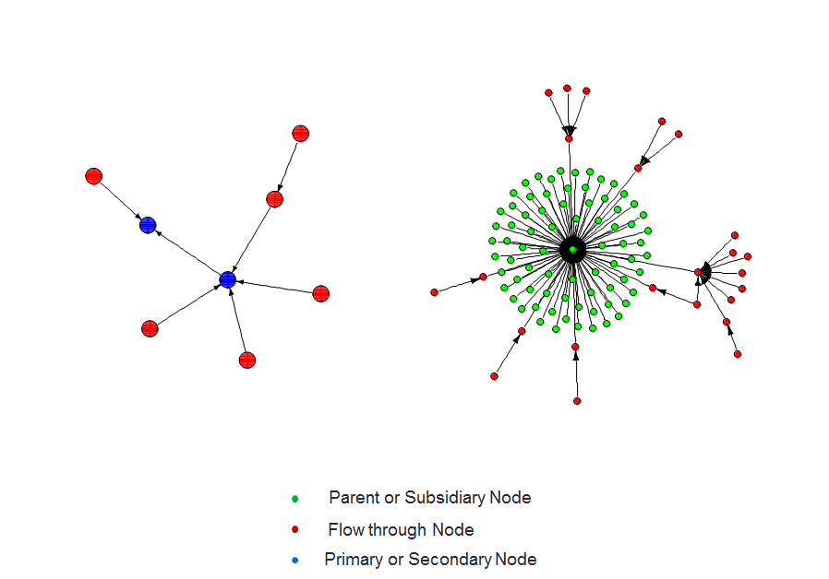
Sample Enterprise Plots
Enterprise X
Enterprise Y

Slide 7
Preliminary Evidence on Our Research Questions
Effort last summer yielded learning how to use YK1 data and applying SNA approach to measure various nodal and linkage characteristics of about 6,000 enterprises in the 1120 LB&I taxpayer population for 2009.
Some measures of network complexity are associated with higher detected noncompliance (proposed deficiencies).
  Controlling for raw predictors of audit selection like size, profitability, DAS.

Slide 8
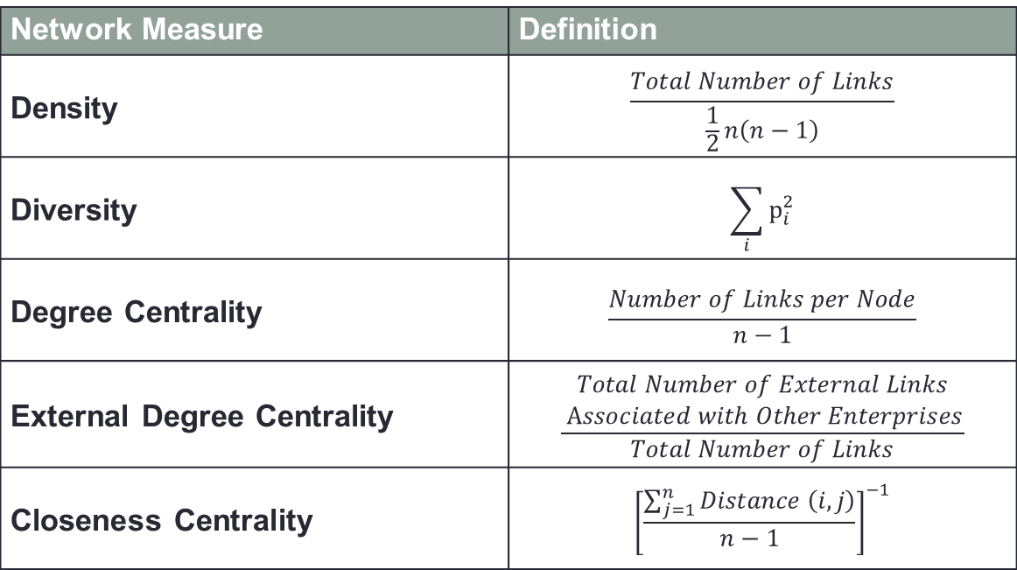
SNA Measures
Network Measure | Definition
Density | $$\frac{Total Number of Links}{\frac{1}{2}n\left(n−1\right)}$$
Diversity | $$\sum_{i}{p_{i}^{2}}$$
Degree Centrality | $$\frac{Number of Links per Node}{n−1}$$
External Degree Centrality | $$\frac{\begin{aligned}Total Number of External Links \\ Associated with Other Enterprises\end{aligned}}{Total Number of Links}$$
Closeness Centrality | $${\left[\frac{\sum_{j=1}^{n}{Distance \left(i, j\right)}}{n−1}\right]}^{−1}$$

Slide 9
Node Diversity
PDD Sample
Random Sample

Slide 10
Degree Centrality
PDD Sample
Random Sample

Slide 11
Centralization & Node Level Degree Centrality
Centralization = 0.05
Centralization = 0.1875
Centralization = 0.45

Slide 12
External Degree Centrality
PDD Sample
Random Sample

Slide 13
Closeness Centrality
PDD Sample
Random Sample

Slide 14
Outlier Analysis

Slide 15
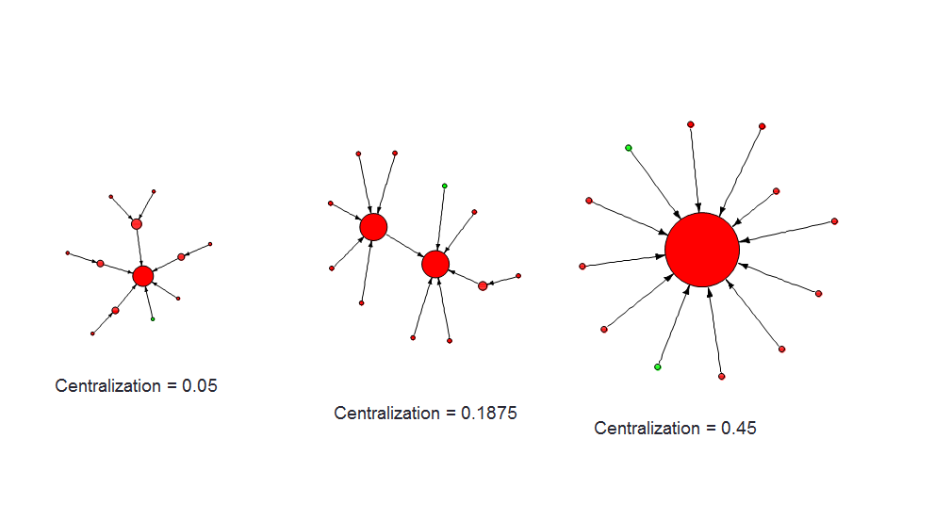
Identifying Economically Important Nodes

Slide 16
Relationship Between Deficiency and SNA Measures (Preliminary Analysis)
Regression:
Deficiency = a₀ + a₁ Assets + a₂ DAS + a₃ NetIncome +
a₄ ClosenessCentrality + a₅ Nodes + a₆ Degree +
a₇ NodeDiversity + a₈ DegreeCentrality
As expected, Deficiencies are higher for larger and more profitable firms.
Relevant to our question, Deficiencies are significantly higher when the nodes are further away (a₄<0) or when the node type is more concentrated (a₇<<0).

Slide 17
Project Status
Initial contract for Ashish Agarwal and Shannon Chen ended September 2014, simple results shown today.
Waiting to re-establish IPA and Disclosure.
Great opportunities for future work when access restored.

Slide 18
Future Work
Refine measures
Generate measures for multiple years
Conduct validation of measures
Explore other enterprise definitions
Contribute to tax administration of complex organizations
Academic Paper on Noncompliance (Agarwal, Chen & Mills)

