Slide 1
Using Supplemental Nutrition Assistance Program Data in EITC Administration
June 18, 2015
Elaine Maag
IRS-TPC Research Conference

Slide 2
Background
Goal: Reduce improper payments of EITC claims
In 2007, 21.2-25.8% of EITC payments estimated to be overclaims; $13.7 - $16.7 billion
Leading cause when type of error is known is claiming non-qualified child
Can state benefit program data help reduce improper payments?

Slide 3
Key EITC Qualifying Elements
Marital Status
Income
Relationship
Residency
Citizenship Status
Student
Disability
3

Slide 4
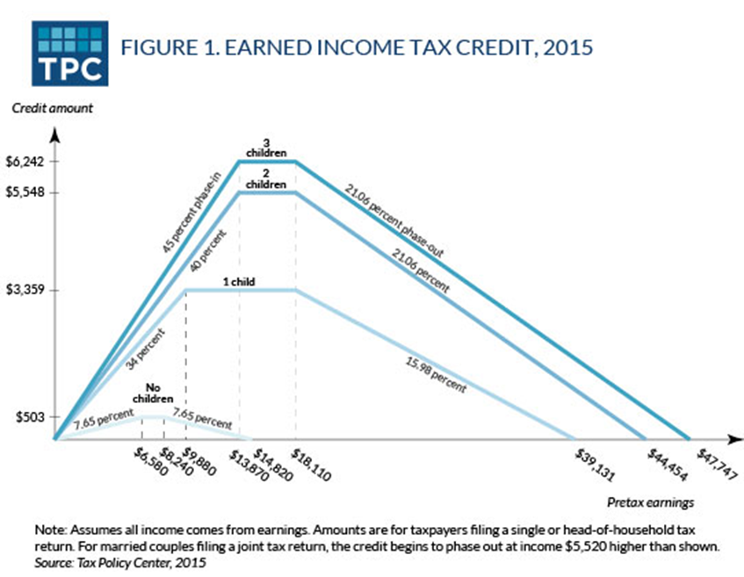
Description of EITC

Slide 5
Description of SNAP

Slide 6
Why SNAP Data Might be Helpful
Some overlap in recipients anticipated
But…some SNAP beneficiaries have no earnings
And…EITC provides benefits to some people with higher incomes than SNAP allows
SNAP benefits based on the group of people who share meals
Can include multiple tax units
SNAP applicants and beneficiaries report living arrangements and relationships to other household members

Slide 7
Problem with SNAP data
Recertify only once or twice each year
We assume if we observe a household that looks the same in two periods, we assume it looked that way in the intervening period.
Monthly vs. annual data
Timing inconsistent with tax year
Self-reported

Slide 8
Tax units in Florida SNAP data

Slide 9
Residency Test: Families with Children

Slide 10
Residency Test: Children Claimed by People Not in SNAP Unit

Slide 11
Residency Test: Summary
Some evidence that people claim different people on their tax returns than they report to SNAP offices
Observe adults in the data without children for at least 6 months
Observe children in the data with different adults for at least 6 months

Slide 12
“Childless” EITC Claims: Presence of Qualifying Child

Slide 13
Outreach
Some people in SNAP data with earnings don’t file tax return
Most have no earnings, are not citizens, or do not have a qualifying childre
11,600 adults appear eligible for the EITC for workers with children

Slide 14
Conclusion
SNAP data can contribute to understanding residency during audit selection, but data are not of high enough quality to use in pre-refund math error authority
Must make assumptions about household stability
Most returns identified with SNAP data were already identified by IRS during audit selection

